Slide 1

Visual Reality
&
Social Media
Haebenn Choi, Yenan Lin, Chieko Tazuke, Jingwen Yang
Notes:
Audience: Client-Facebook, story-telling
Feedback: disconnection from insight to concepts
2rd concept(consistent, drawing)

Slide 2
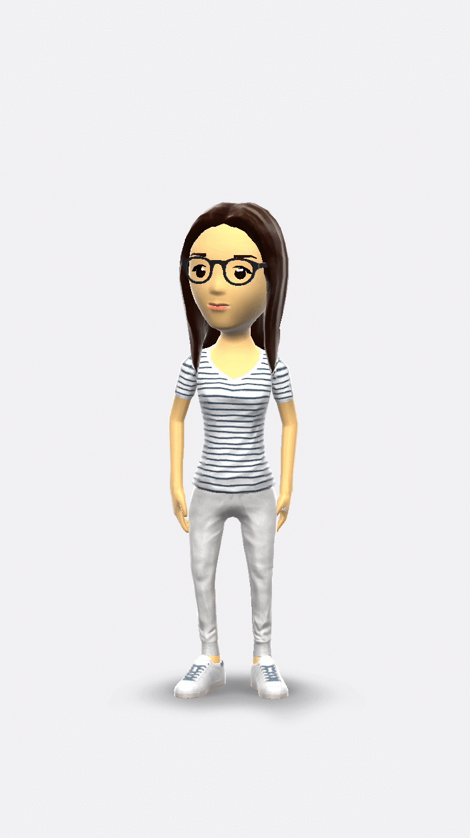
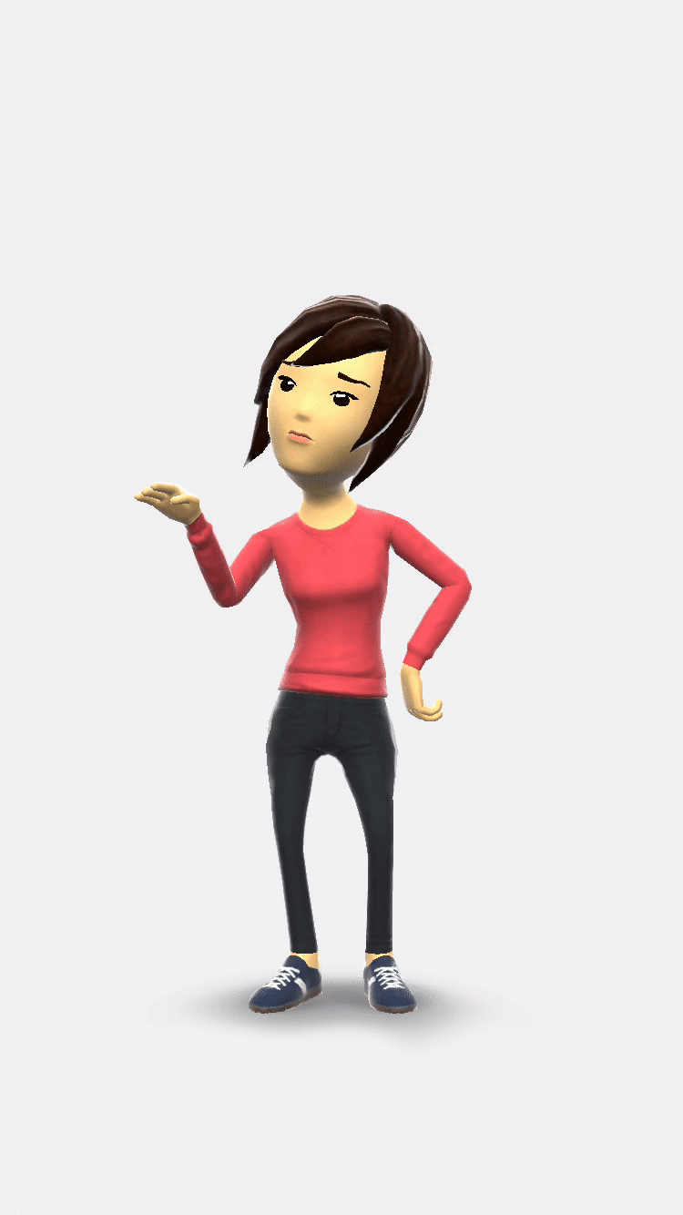
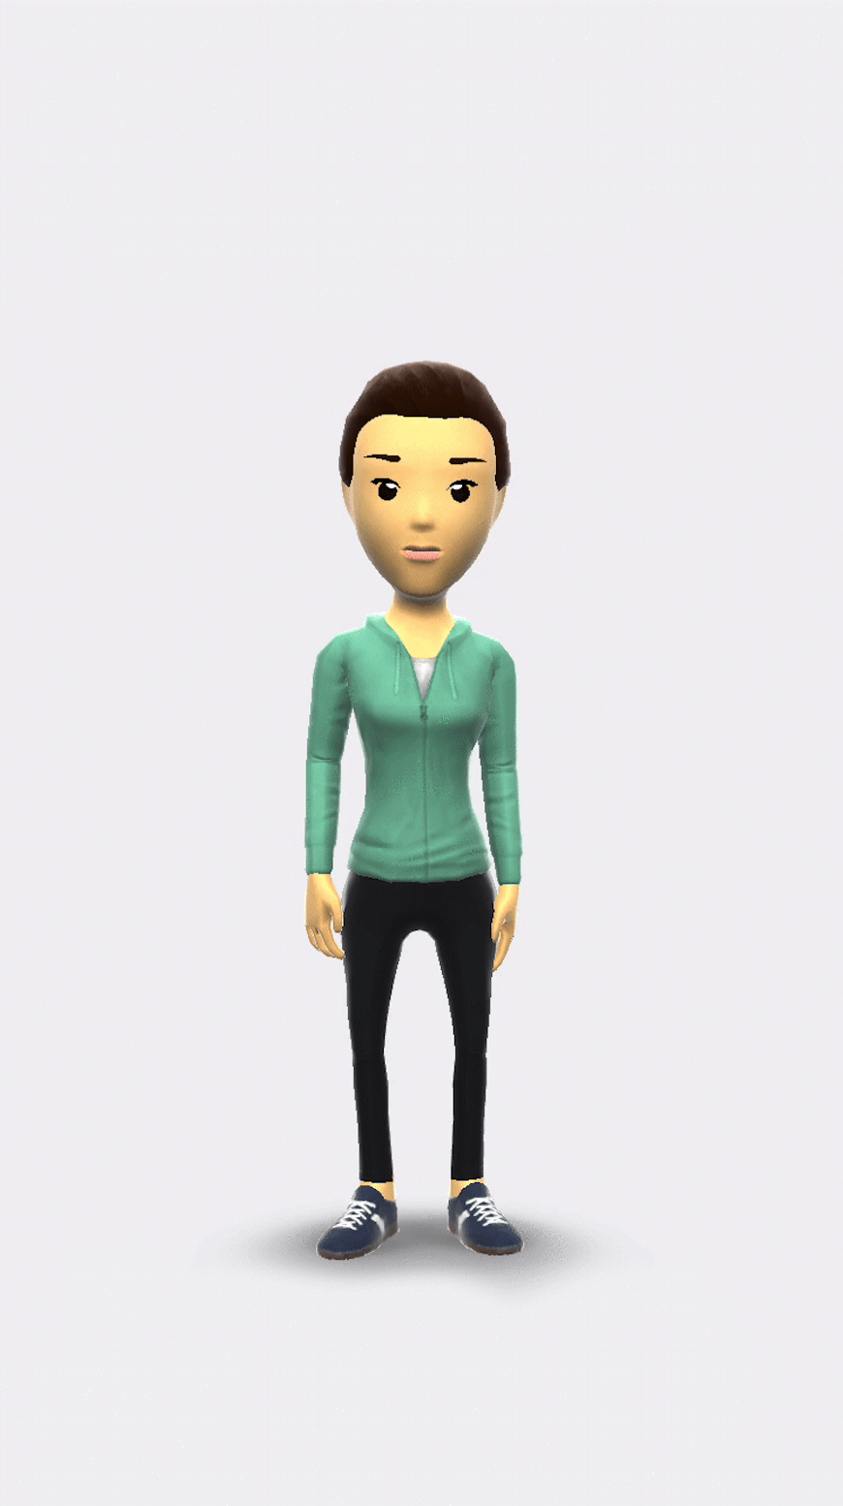
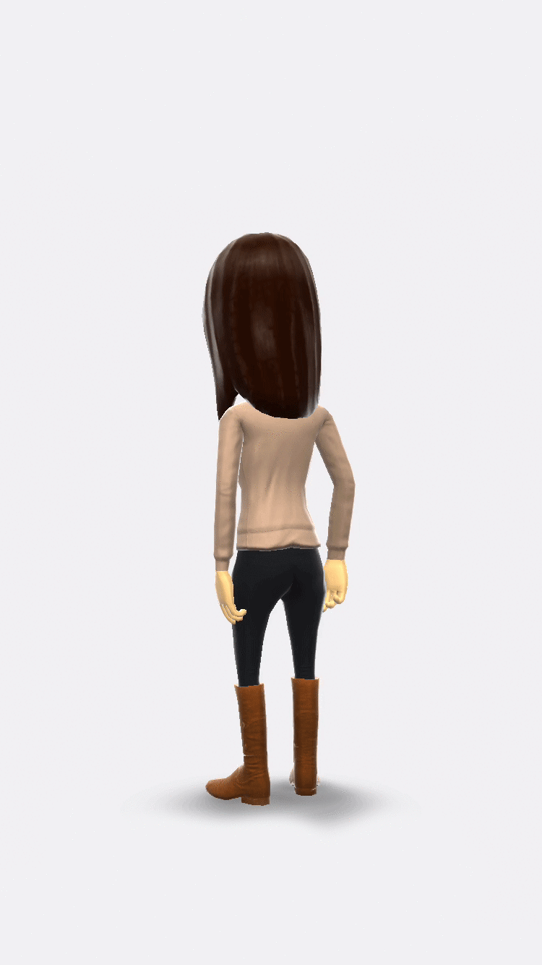
four avatars
Jingwen
Chieko
Haebeen
Sophie

Slide 3
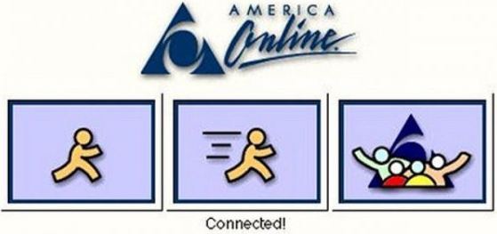
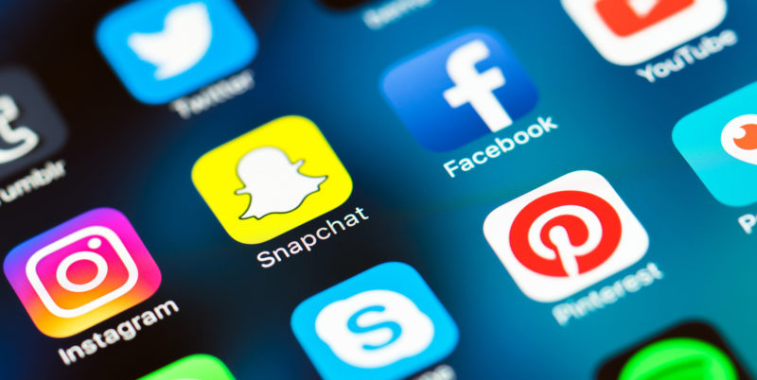
Social Media - how people are connected
1990s
2010s
VS
Long texts
Strong ties
Personal
Short texts, images, videos
Weak ties
Public
Notes:
Human beings have explored the ways of long distance communication over centuries. In 1990s, people were connected by e-mails by sending long text messages. This interaction built close, strong ties among them. Now many people use facebook as a platform of communication. We can send short text messages, images and videos immediately without any cost. As we can contact with people very easily and instantly, each bond becomes weaker.
http://blog.scienceborealis.ca/youve-got-mail-and-everything-else-whats-a-science-blogger-to-do/
http://marketingland.com/library/channel/social-media-marketing

Slide 4
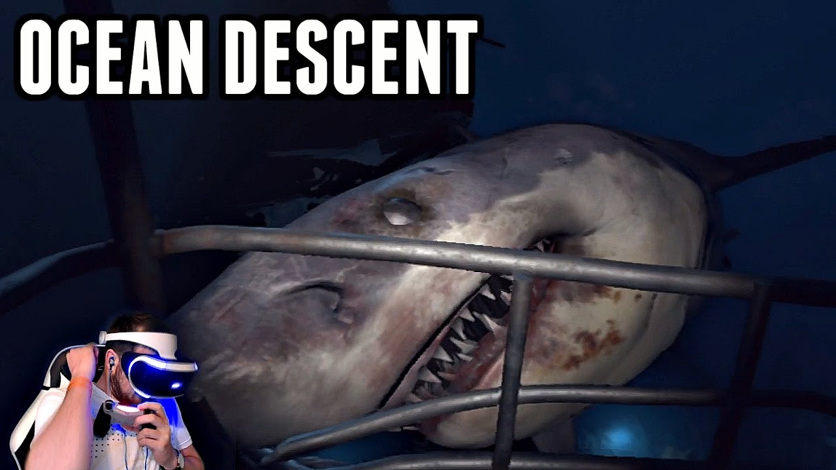
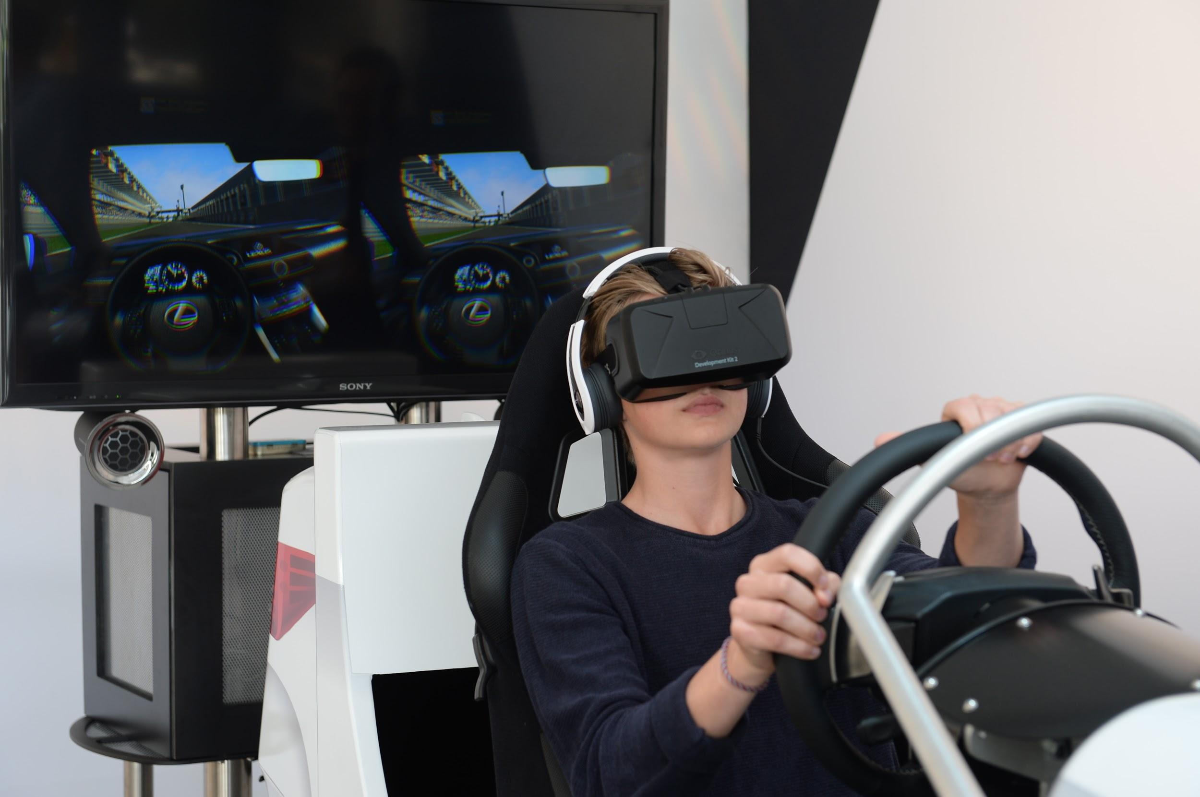
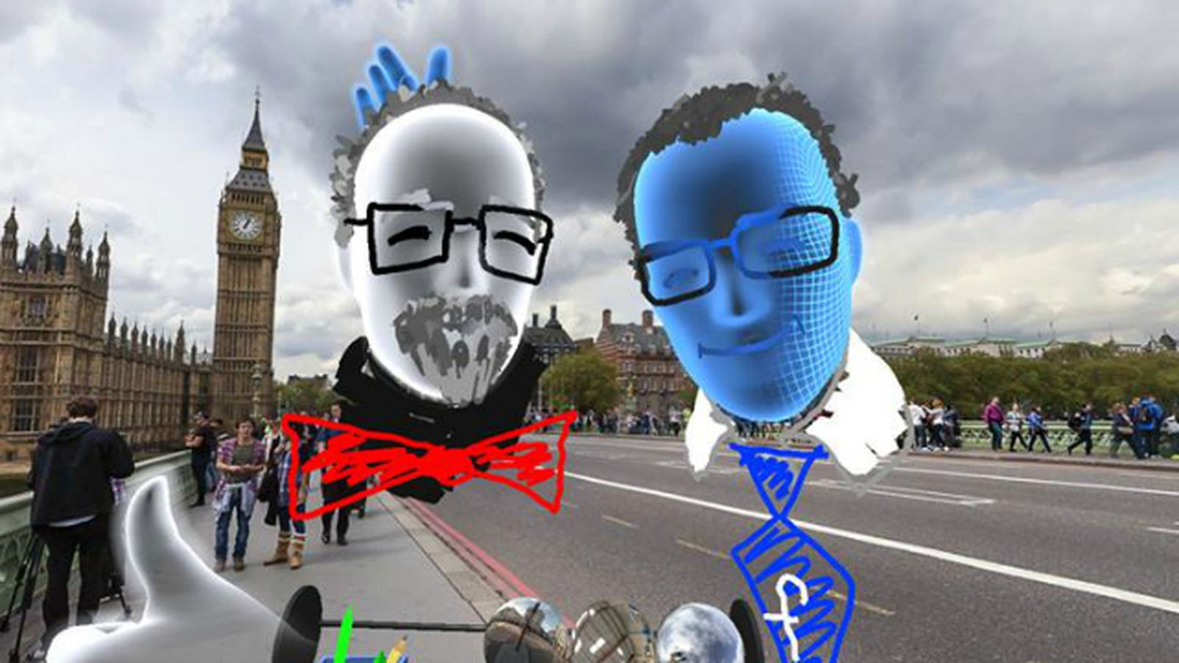
VR - how people feel real environment
Game
Simulation
Social VR
Notes:
VR is a technology that we can experience real environment in a cyber space. It is originally developed in gaming and simulation areas, but we think there is a possibility to strengthen our connection between individuals.
https://www.youtube.com/watch?v=ggNvYqHKeaQ
http://venturebeat.com/2014/10/01/a-true-virtual-showroom-lexus-and-oculus-rift-show-the-potential-sales-power-of-vr/
http://www.recode.net/2016/4/13/11586098/watch-facebook-social-virtual-reality-demo

Slide 5
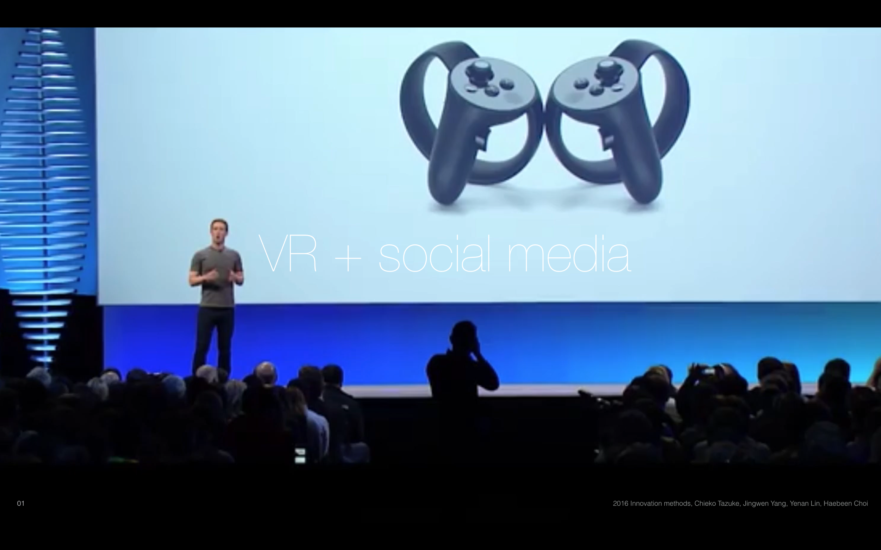
Intent statement
We would like to explore how people can use a virtual reality technology through social media in the future.
This is not just moments with their friends online, but entire experiences and adventures.
Our goal is to find what is humanizing VR experiences
in the context of social context.

Slide 6
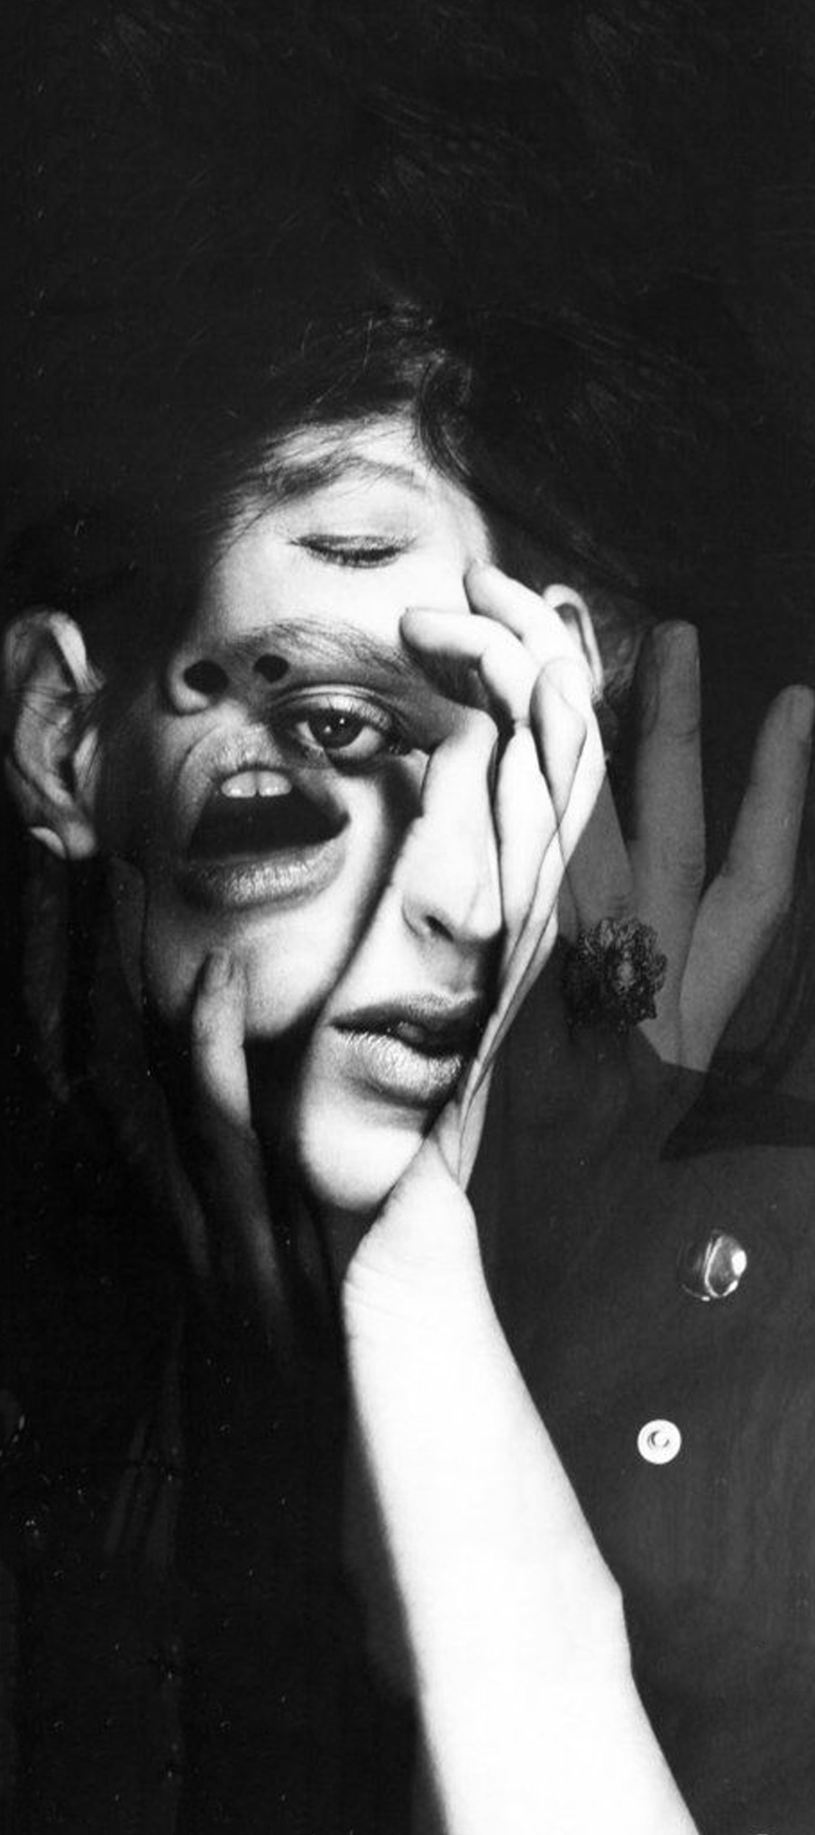
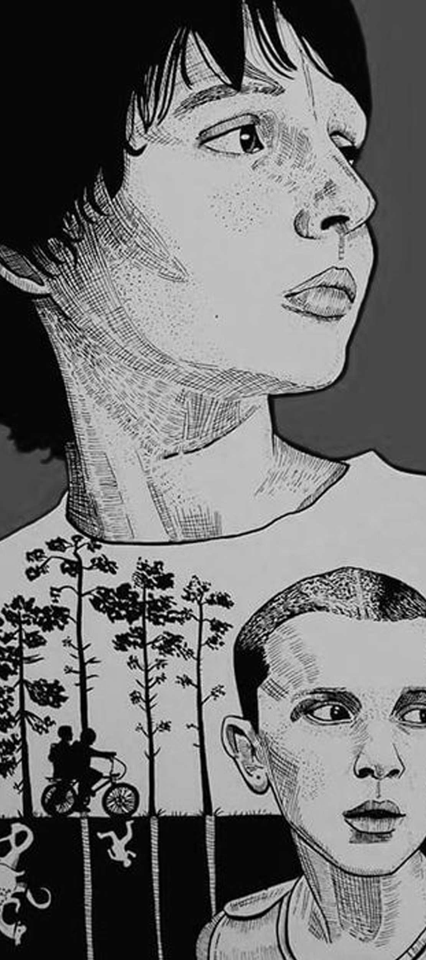
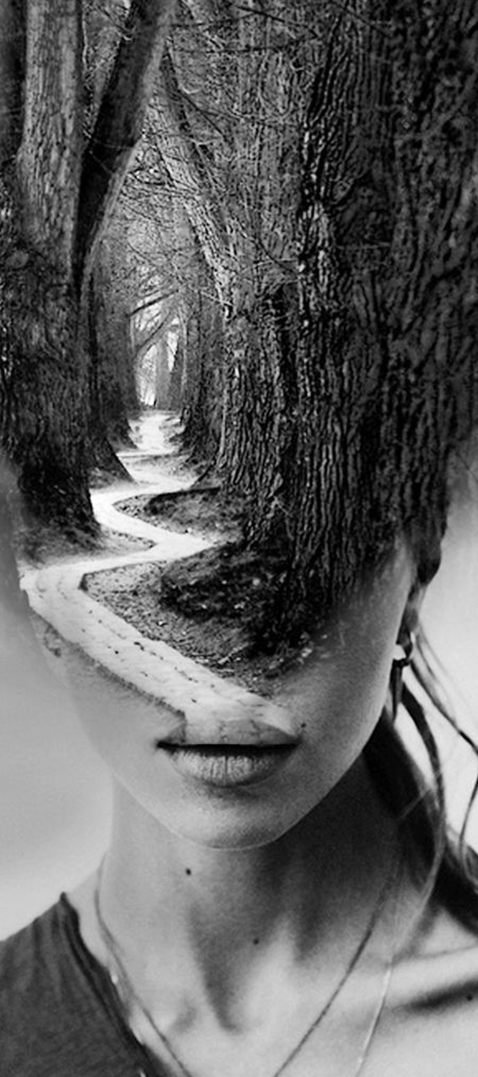
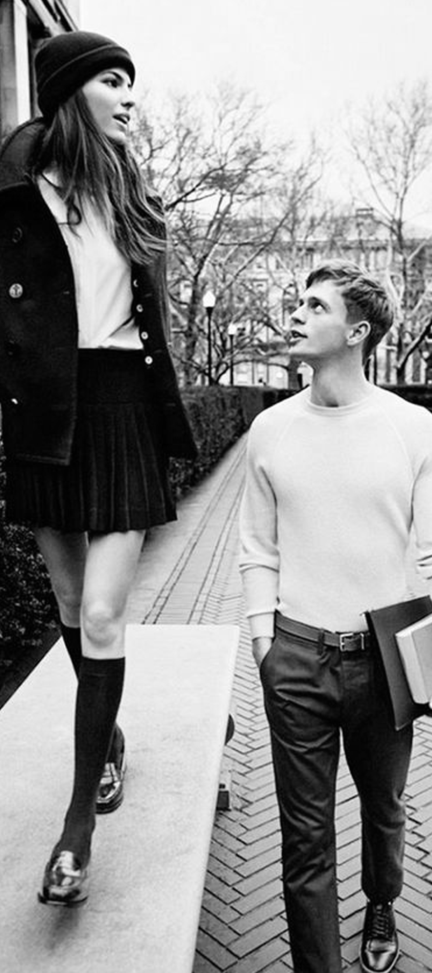
What we heard
“I would prefer to do hug or gestures... in some situations (a loss of their family).”
“I sometimes make a call about someone's post.”
“I want to explain more detailed stories by writing long articles with many photos.”
“I post some daily life experiences as a way of communicating with people who I rarely meet.”
“I use a hashtag, #, to find the person who might have same interests.”
“FB is for friends and family, not for the public.”
“I would post some photos in a invisible way, or in my own group chatting.”
“ I prefer multifunctional platforms because I can easily categorize things.”
“I want to talk with my friends through a Facetime video while having a meal because I feel more become close to my friends.”
“Mostly, I use a phone to talk with my parents about their news but, when we need to make an important decision for our family, we tried to connect to all family members. It feels like a talking with my family in the living room.”

Slide 7
What we heard
“I would prefer to do hug or gestures... in some situations (a loss of their family).”
“I sometimes make a call about someone's post.”
“I want to explain more detailed stories by writing long articles with many photos.”
I want to feel emotion and feelings from others on social media.
“I post some daily life experiences as a way of communicating with people who I rarely meet.”
“I use a hashtag, #, to find the person who might have same interests.”
“FB is for friends and family, not for the public.”
“I would post some photos in a invisible way, or in my own group chatting.”
“ I prefer multifunctional platforms because I can easily categorize things.”
“I want to talk with my friends through a Facetime video while having a meal because I feel more become close to my friends.”
“Mostly, I use a phone to talk with my parents about their news but, when we need to make an important decision for our family, we tried to connect to all family members. It feels like a talking with my family in the living room.”

Slide 8
What we heard
“I would prefer to do hug or gestures... in some situations (a loss of their family).”
“I sometimes make a call about someone's post.”
“I want to explain more detailed stories by writing long articles with many photos.”
“I post some daily life experiences as a way of communicating with people who I rarely meet.”
“I use a hashtag, #, to find the person who might have same interests.”
“FB is for friends and family, not for the public.”
“I would post some photos in a invisible way, or in my own group chatting.”
“ I prefer multifunctional platforms because I can easily categorize things.”
“I want to talk with my friends through a Facetime video while having a meal because I feel more become close to my friends.”
“Mostly, I use a phone to talk with my parents about their news but, when we need to make an important decision for our family, we tried to connect to all family members. It feels like a talking with my family in the living room.”

Slide 9
What we heard
“I would prefer to do hug or gestures... in some situations (a loss of their family).”
“I sometimes make a call about someone's post.”
“I want to explain more detailed stories by writing long articles with many photos.”
“I post some daily life experiences as a way of communicating with people who I rarely meet.”
“I use a hashtag, #, to find the person who might have same interests.”
I want to build strong relationships even we are far from each other and don’t know before.
“FB is for friends and family, not for the public.”
“I would post some photos in a invisible way, or in my own group chatting.”
“ I prefer multifunctional platforms because I can easily categorize things.”
“I want to talk with my friends through a Facetime video while having a meal because I feel more become close to my friends.”
“Mostly, I use a phone to talk with my parents about their news but, when we need to make an important decision for our family, we tried to connect to all family members. It feels like a talking with my family in the living room.”

Slide 10
What we heard
“I would prefer to do hug or gestures... in some situations (a loss of their family).”
“I sometimes make a call about someone's post.”
“I want to explain more detailed stories by writing long articles with many photos.”
“I post some daily life experiences as a way of communicating with people who I rarely meet.”
“I use a hashtag, #, to find the person who might have same interests.”
“FB is for friends and family, not for the public.”
“I would post some photos in a invisible way, or in my own group chatting.”
“ I prefer multifunctional platforms because I can easily categorize things.”
“I want to talk with my friends through a Facetime video while having a meal because I feel more become close to my friends.”
“Mostly, I use a phone to talk with my parents about their news but, when we need to make an important decision for our family, we tried to connect to all family members. It feels like a talking with my family in the living room.”

Slide 11
What we heard
“I would prefer to do hug or gestures... in some situations (a loss of their family).”
“I sometimes make a call about someone's post.”
“I want to explain more detailed stories by writing long articles with many photos.”
“I post some daily life experiences as a way of communicating with people who I rarely meet.”
“I use a hashtag, #, to find the person who might have same interests.”
I want to integrate my memories and control privacy on the platform.
“FB is for friends and family, not for the public.”
“I would post some photos in a invisible way, or in my own group chatting.”
“ I prefer multifunctional platforms because I can easily categorize things.”
“I want to talk with my friends through a Facetime video while having a meal because I feel more become close to my friends.”
“Mostly, I use a phone to talk with my parents about their news but, when we need to make an important decision for our family, we tried to connect to all family members. It feels like a talking with my family in the living room.”

Slide 12
What we heard
“I would prefer to do hug or gestures... in some situations (a loss of their family).”
“I sometimes make a call about someone's post.”
“I want to explain more detailed stories by writing long articles with many photos.”
“I post some daily life experiences as a way of communicating with people who I rarely meet.”
“I use a hashtag, #, to find the person who might have same interests.”
“FB is for friends and family, not for the public.”
“I would post some photos in a invisible way, or in my own group chatting.”
“ I prefer multifunctional platforms because I can easily categorize things.”
“I want to talk with my friends through a Facetime video while having a meal because I feel more become close to my friends.”
“Mostly, I use a phone to talk with my parents about their news but, when we need to make an important decision for our family, we tried to connect to all family members. It feels like a talking with my family in the living room.”

Slide 13
What we heard
“I would prefer to do hug or gestures... in some situations (a loss of their family).”
“I sometimes make a call about someone's post.”
“I want to explain more detailed stories by writing long articles with many photos.”
“I post some daily life experiences as a way of communicating with people who I rarely meet.”
“I use a hashtag, #, to find the person who might have same interests.”
“FB is for friends and family, not for the public.”
“I would post some photos in a invisible way, or in my own group chatting.”
“ I prefer multifunctional platforms because I can easily categorize things.”
I want to facilitate my conversation by using either activities or environment.
“I want to talk with my friends through a Facetime video while having a meal because I feel more become close to my friends.”
“Mostly, I use a phone to talk with my parents about their news but, when we need to make an important decision for our family, we tried to connect to all family members. It feels like a talking with my family in the living room.”

Slide 14
Users’ needs
I want to feel emotion and feelings from others on social media.
I want to build strong relationships even we are far from each other and don’t know before.
I want to integrate my memories and control privacy on the platform.
I want to facilitate my conversation by using either activities or environment.
Notes:
Emotion is solved by using VR head set.
Building strong relationships > Host event
Memories > Gallery

Slide 15
Design principles for facebook
Current facebook platform
Future Facebook with VR
Get reactions from others after posting pictures/video by comments
Keep your memories and share them at the same time
Broadcast your thoughts to others
Intimidate reactions from others after posting on Facebook VR
Customized sorting your memories and sharing them with specific people
One on one interaction

Slide 16

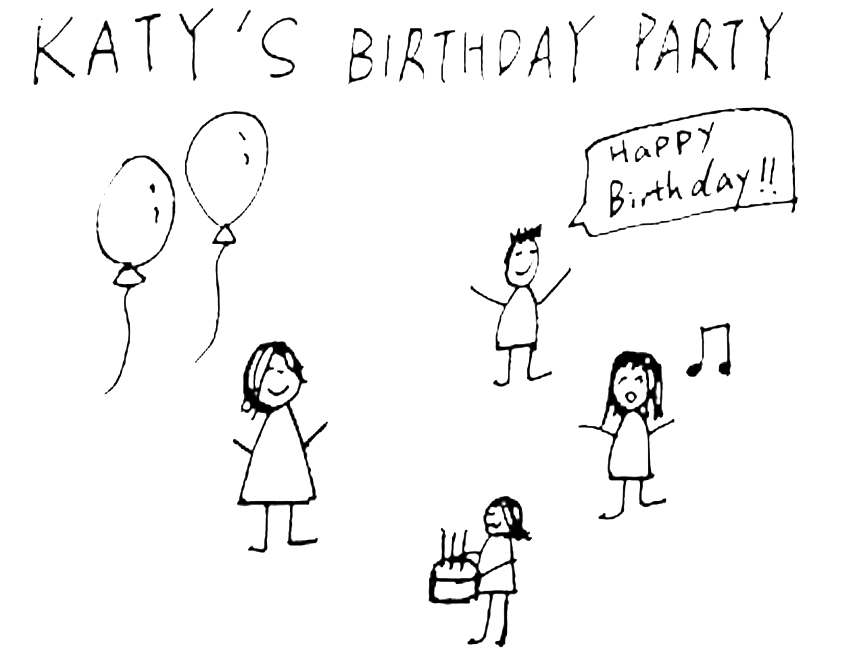

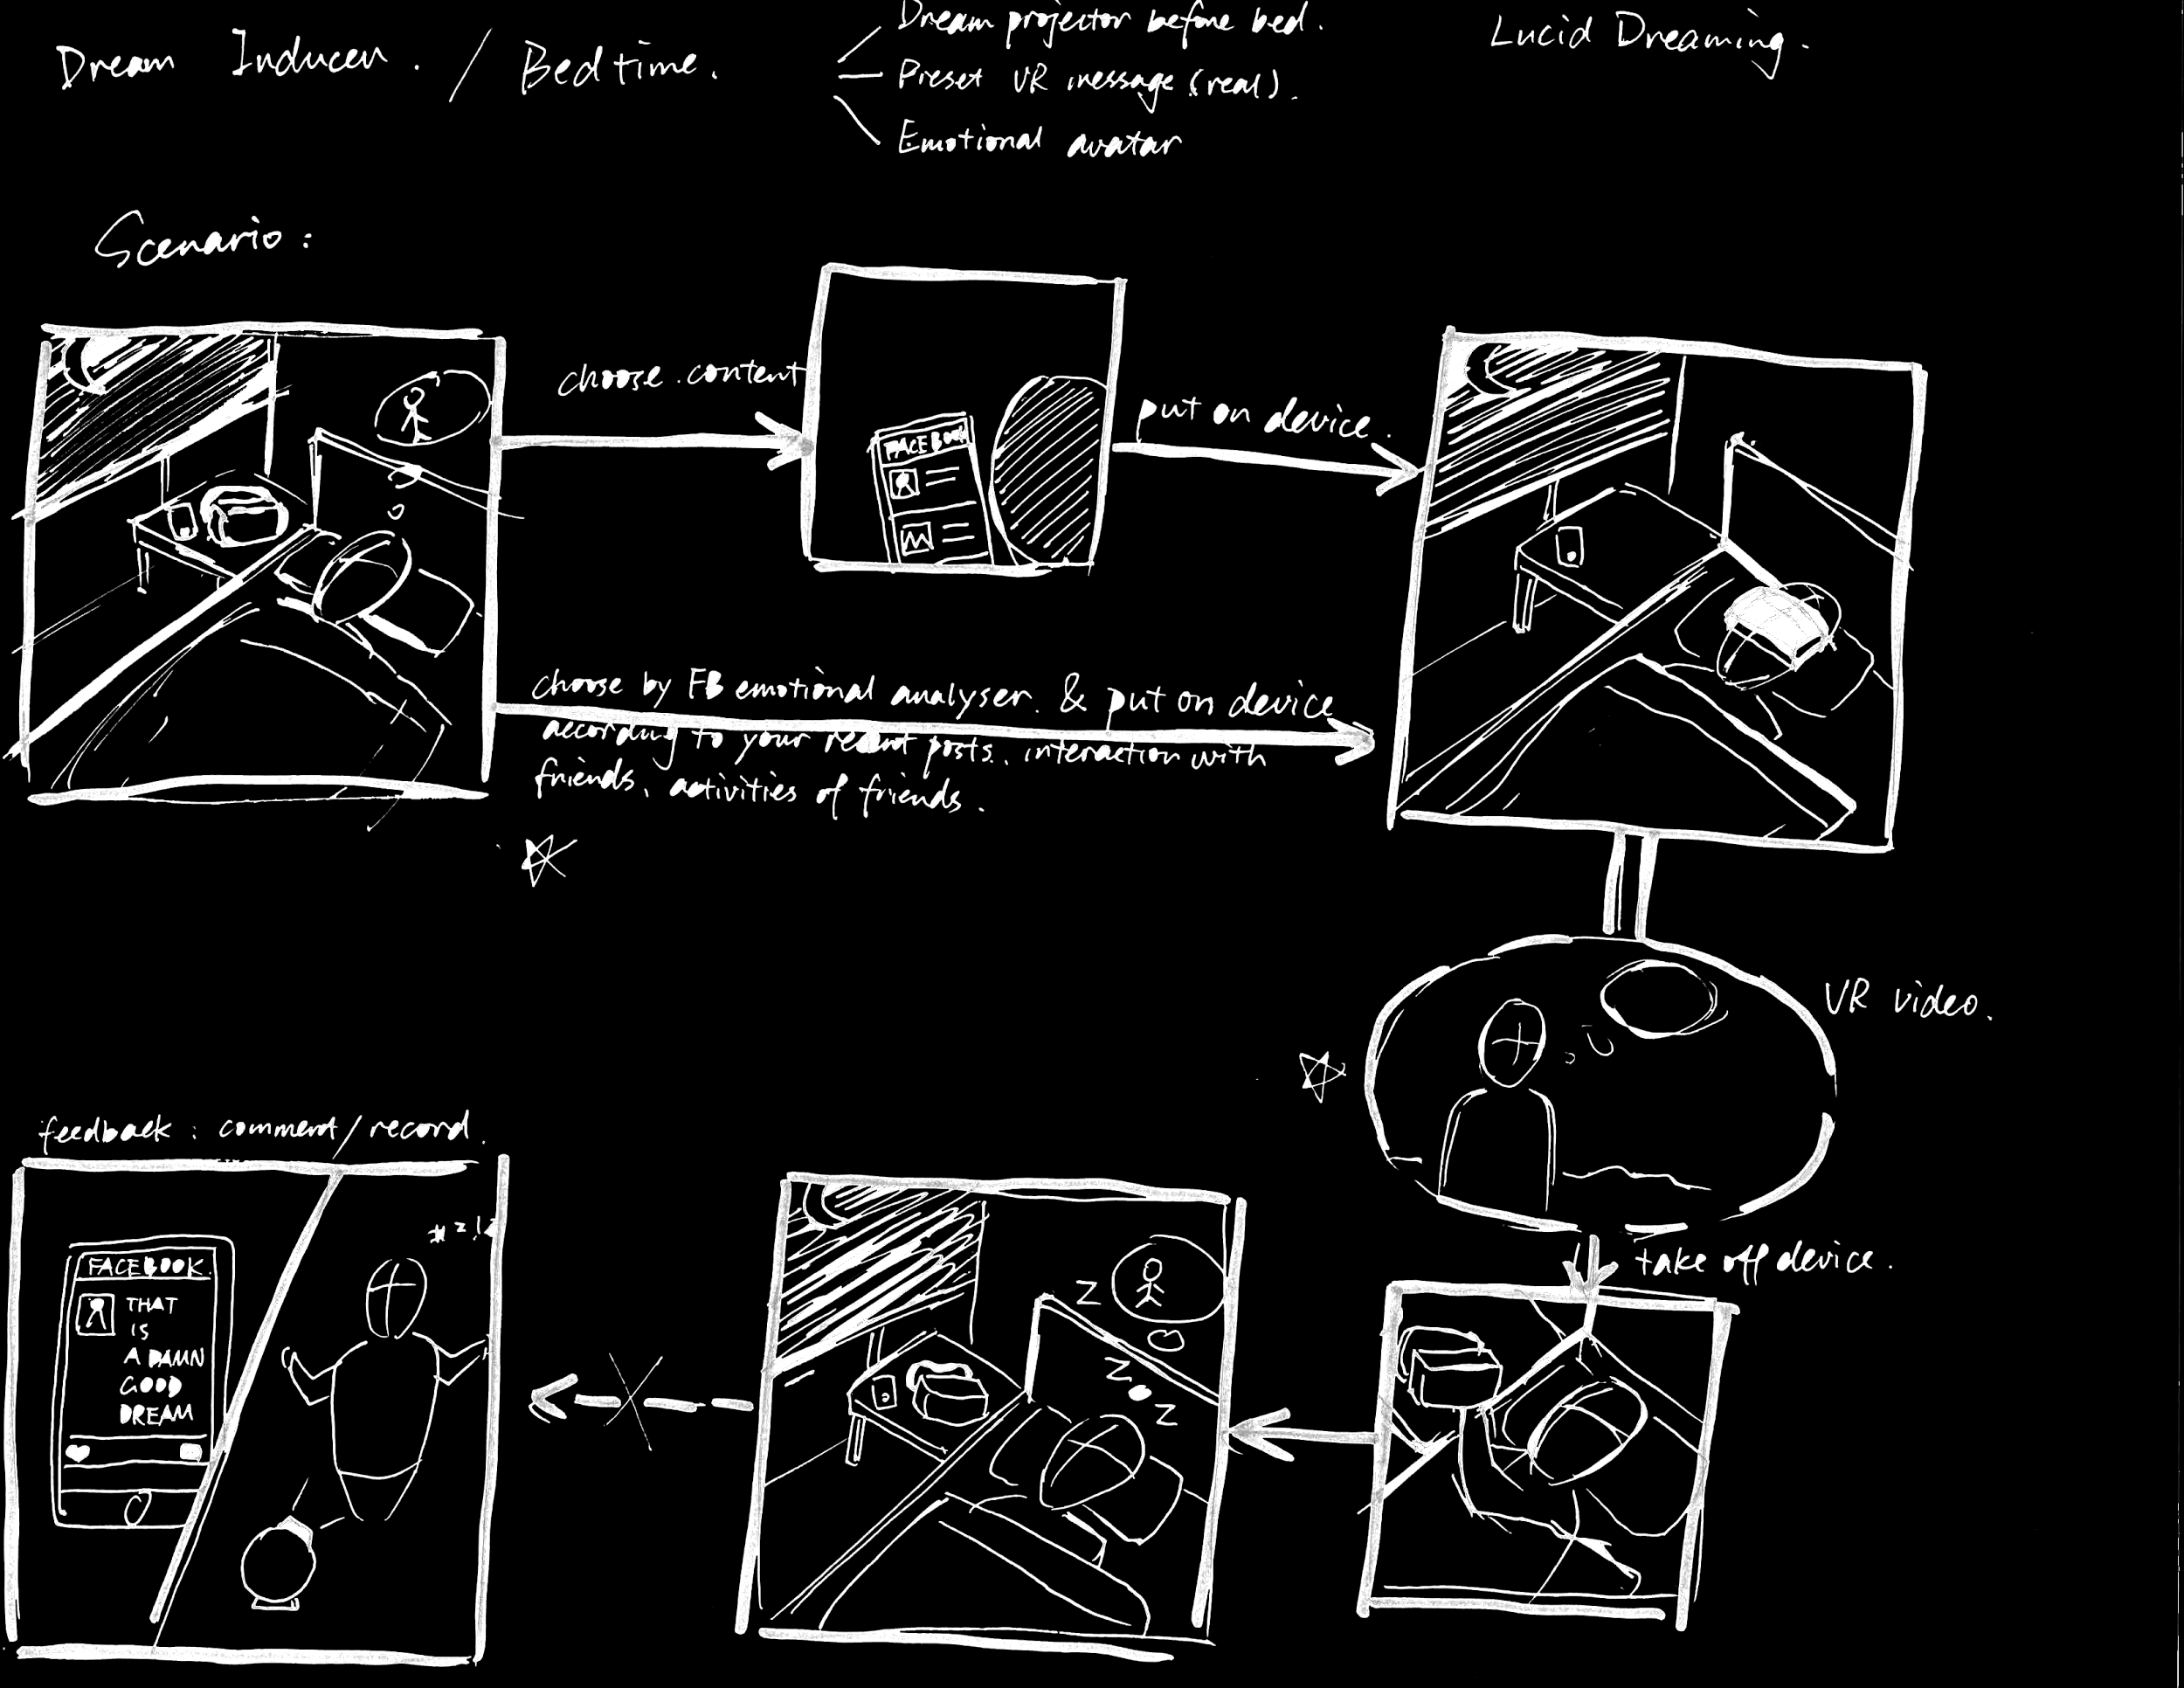
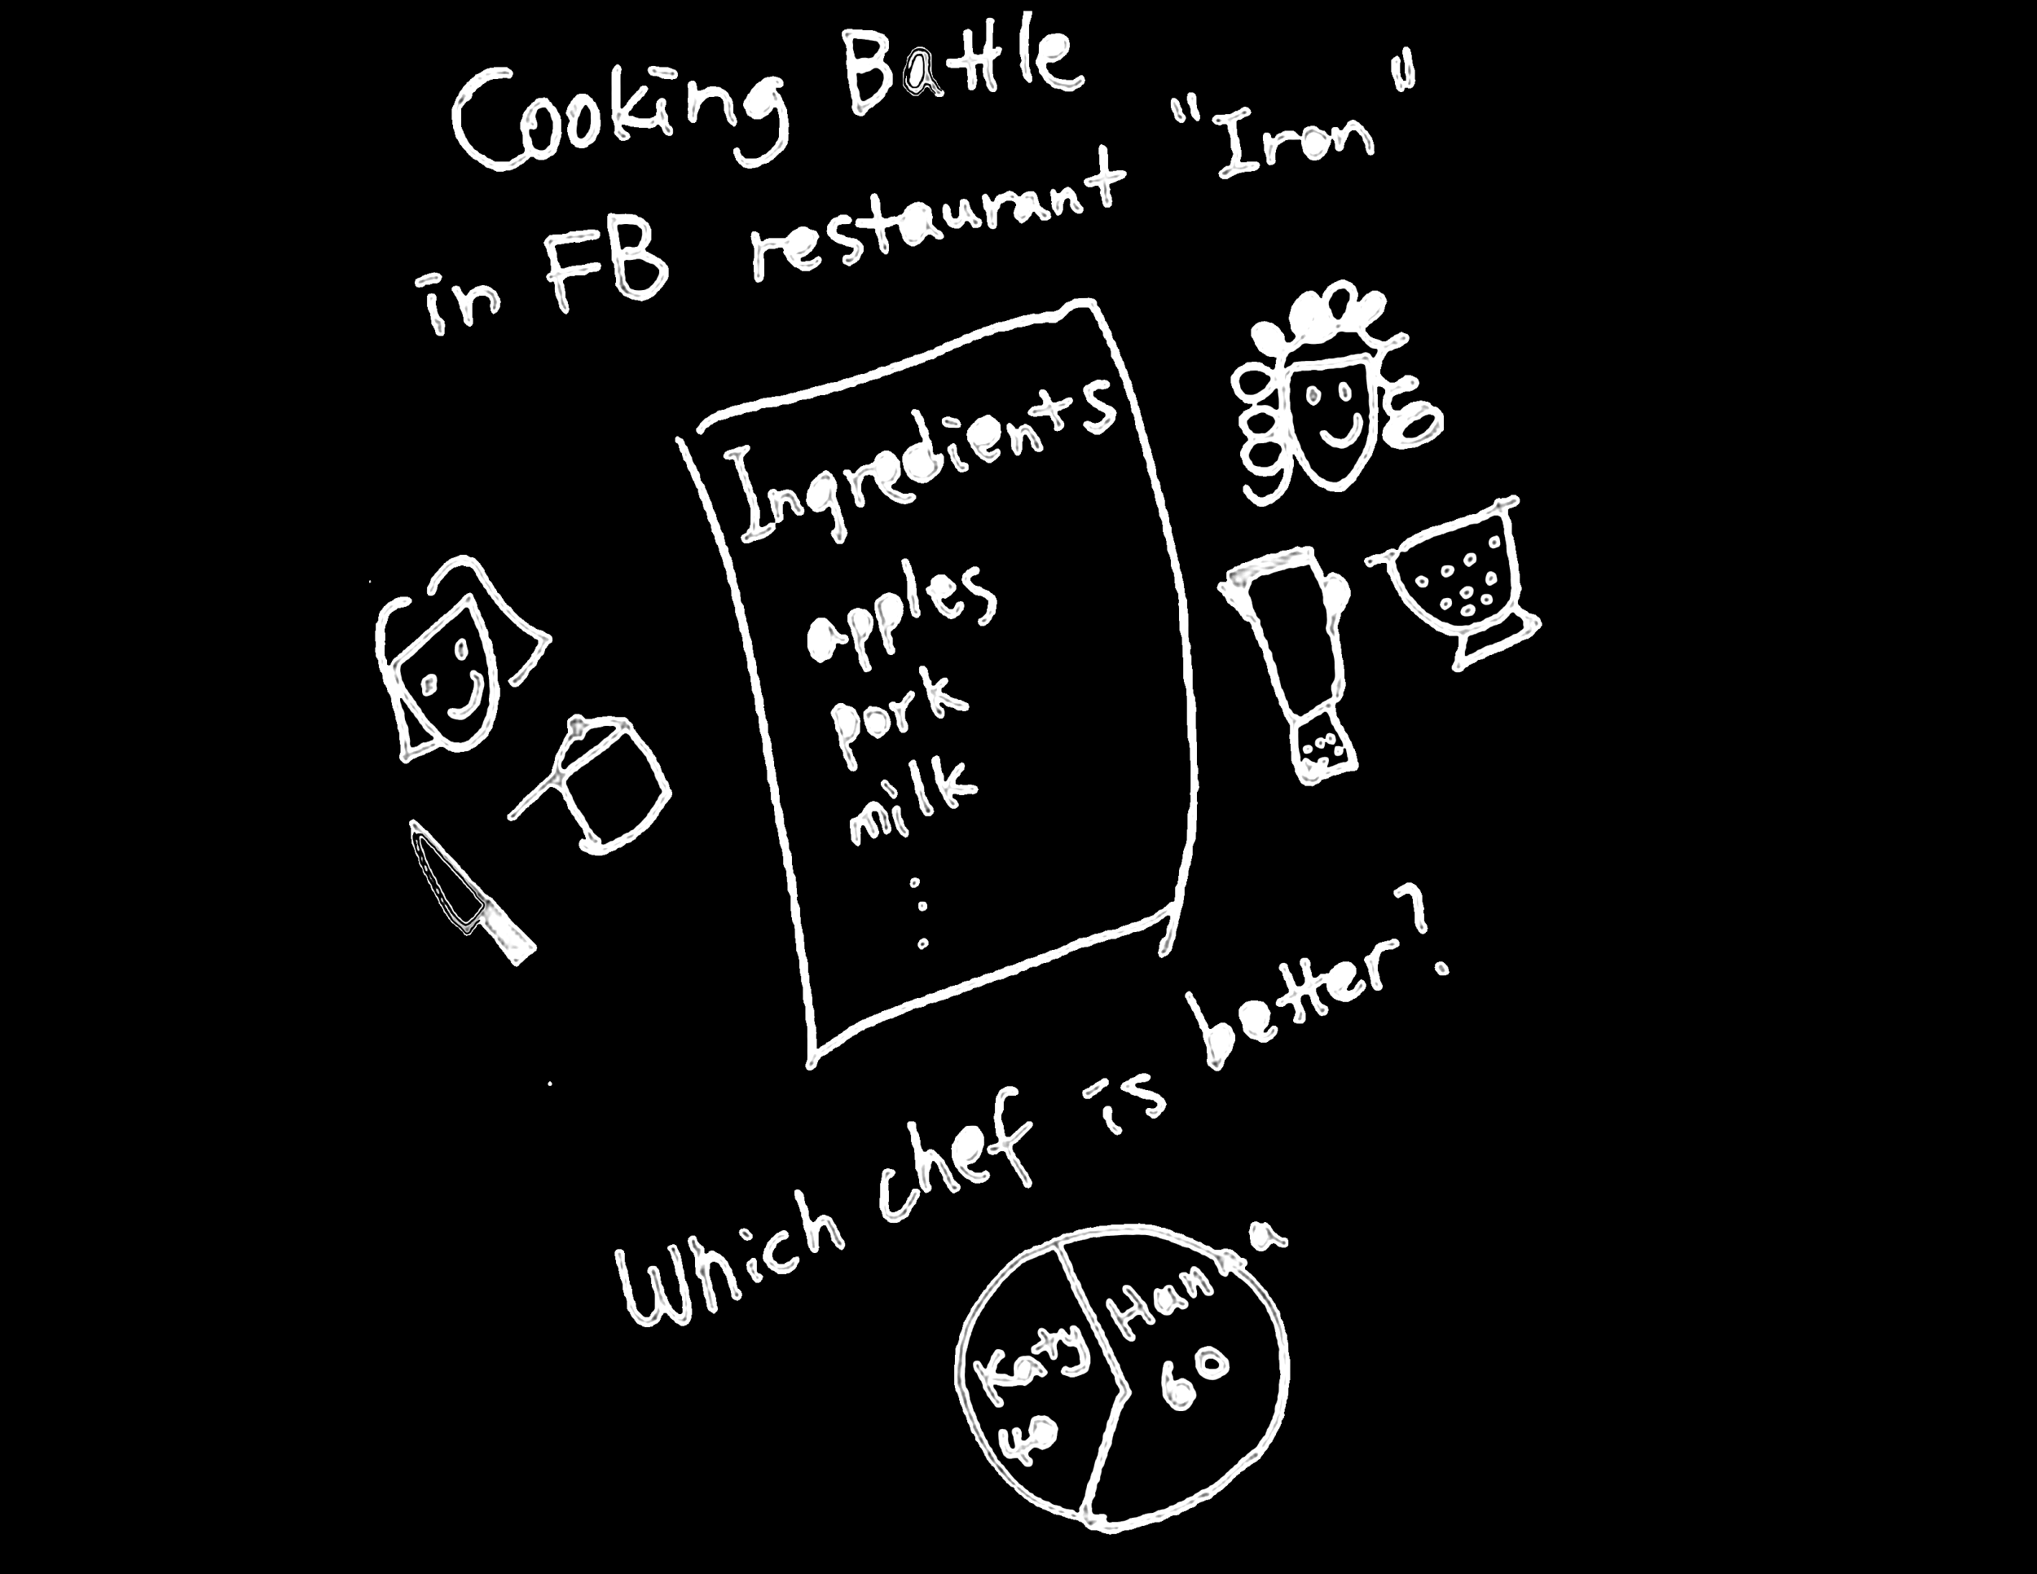
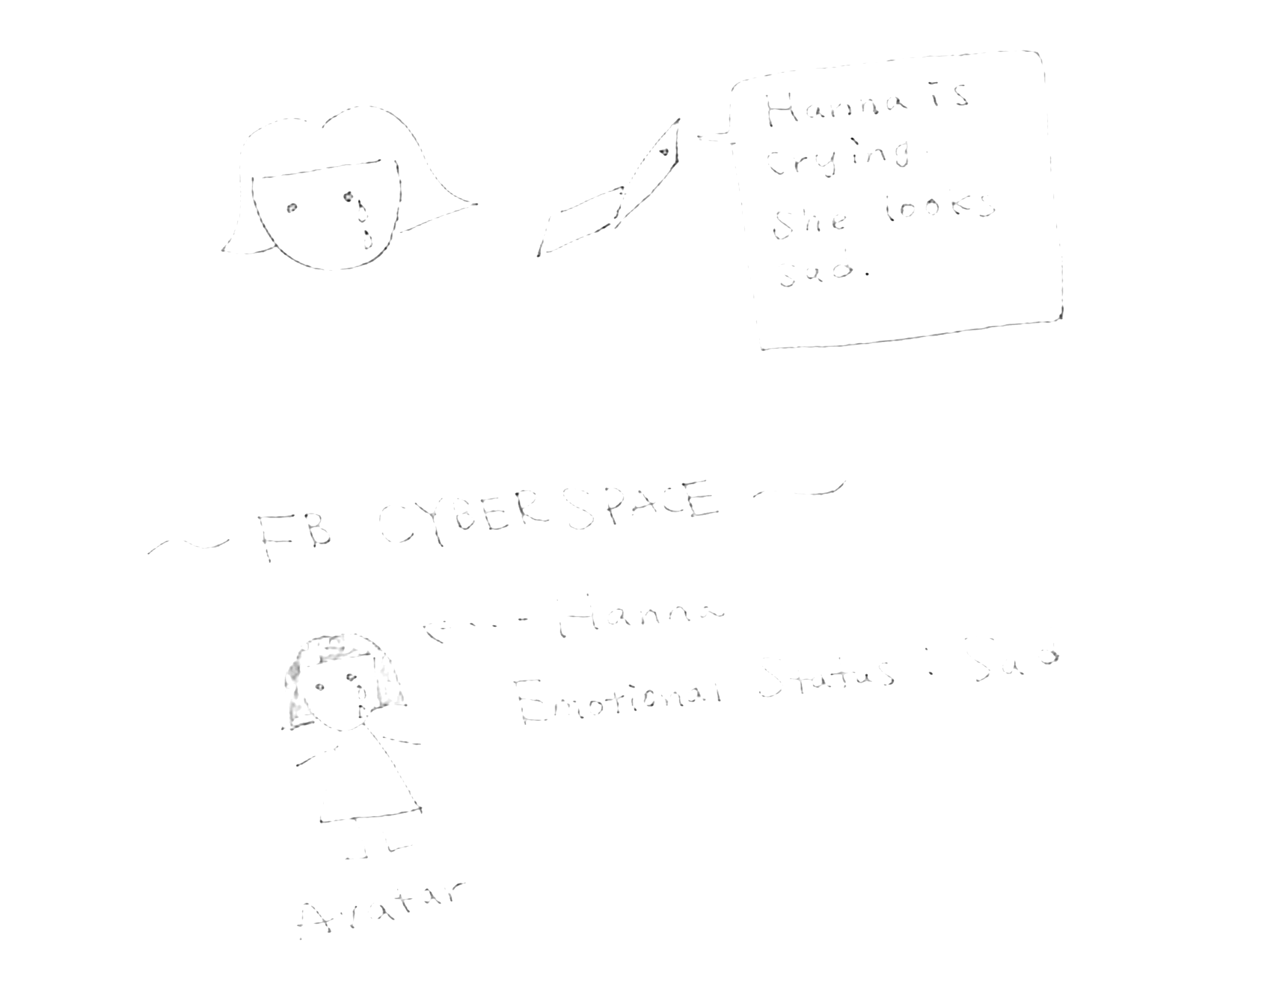
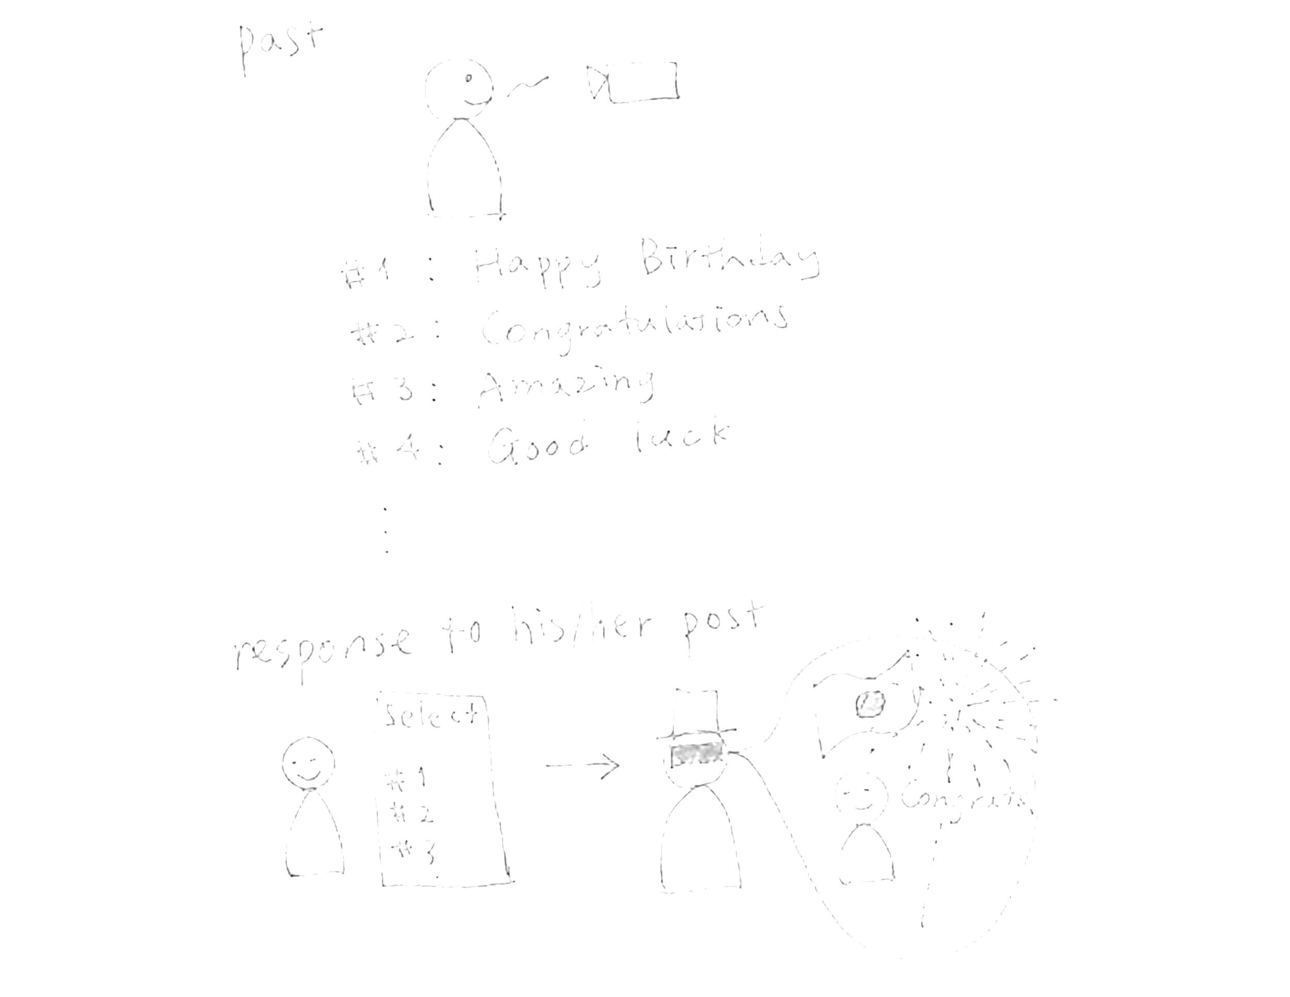
Concept 1 - Host events in virtual space
Concept 2 - VR Gallery
Concept 3 - Dream Inducer
Notes:
real time communication with friends who live far away

Slide 17

CONCEPT 1 - Host events in virtual space
Problem
What is the concept?
People live far away from each other can hardly feel others’ emotion and feeling.
Users can host real-time events in VR space with friends or pre-set their message to send. People can have fun in VR space even they can not meet.

Slide 18
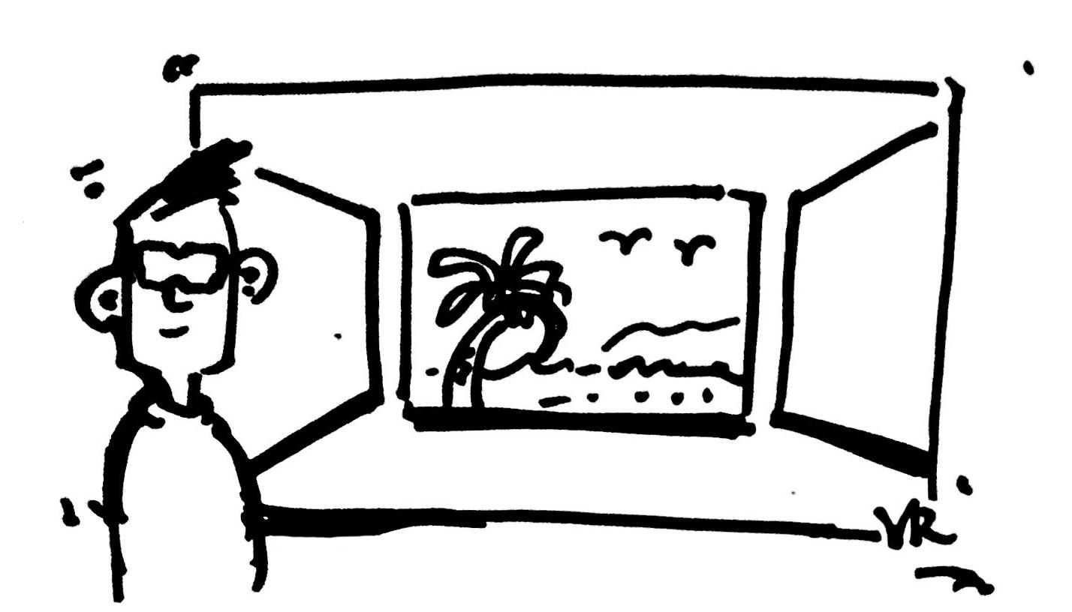
CONCEPT 1 - Host events in virtual space
ORGANIZER: SET UP
Peter’s Birthday Party
1. Peter uses facebook to set up a virtual space to hold his birthday party.
2. Preset scenarios and props are provided for him to customize the space.
Notes:
Typical scenario:
Peter uses facebook to set up a virtual space to hold his birthday party.
Preset scenarios and props are provided for him to customize the space.
His facebook friends join the party by avatar and celebrate.
Friends can send virtual hugs, gifts and emojis.
They can enjoy a great time playing games together.
Friends that can not join in time can send preset audio/video messages.
Peter records the 360 video as memory in facebook
http://www.phonearena.com/news/How-to-record-screen-video-on-Android-5.0-Lollipop-no-root-required_id62678.
http://zugara.com/virtual-dressing-room-technology/webcam-social-shopper#prettyPhoto

Slide 19

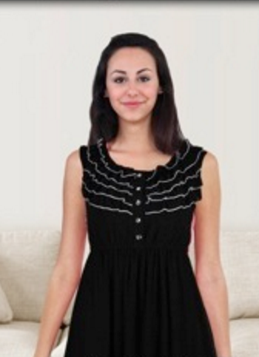
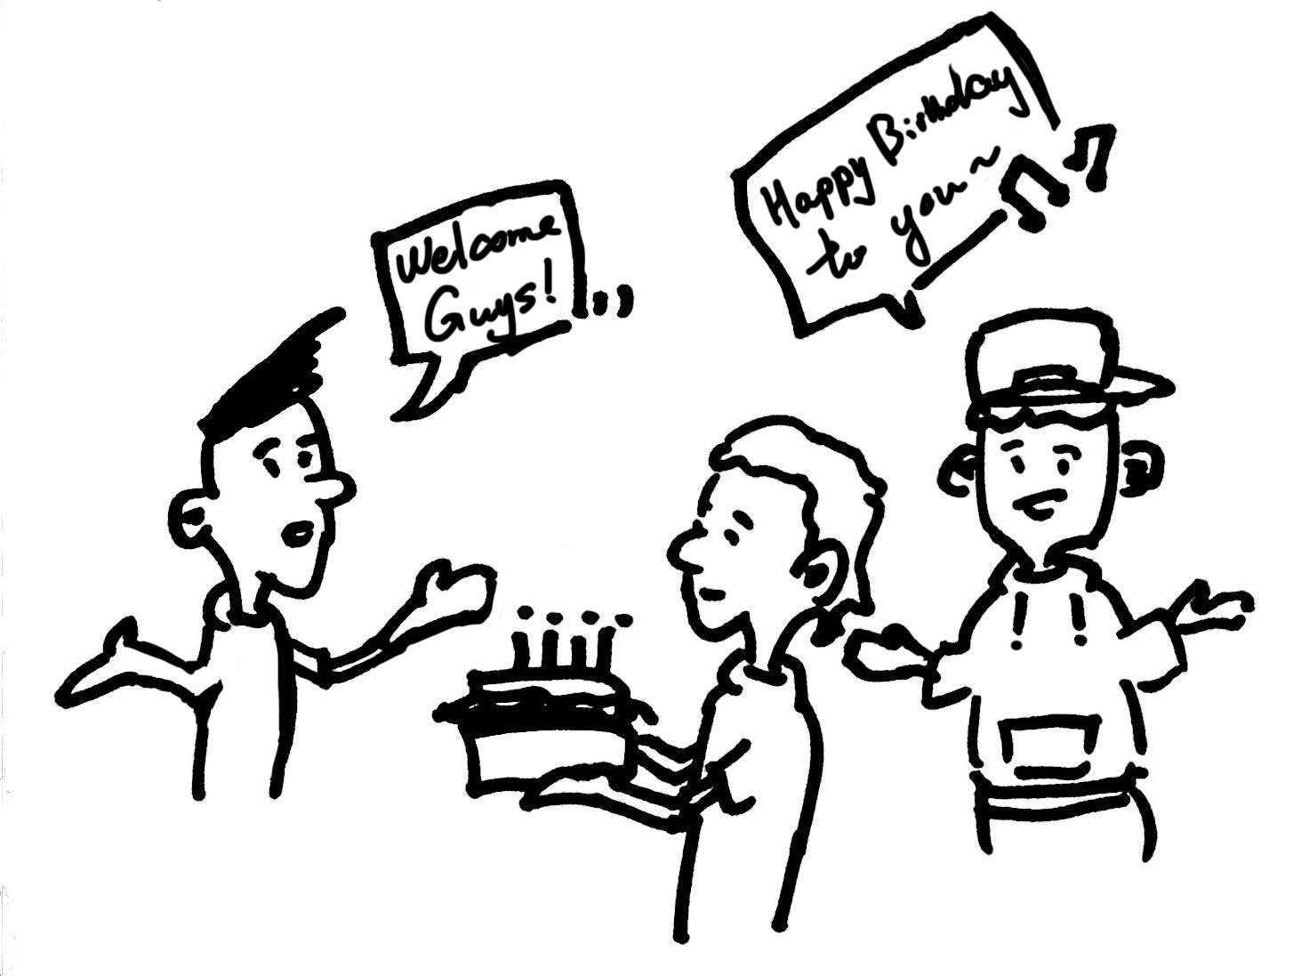
CONCEPT 1 - Host events in virtual space
FRIENDS: JOIN
RECORD THE EVENT
VR SPACE
7. Peter records the 360 video as memory in facebook.
Real (Video preset)
Half real/half avatar
5. Friends can send virtual hugs, gifts and emojis.
6. They can enjoy a great time playing games together.
Avatar (Real time)
3. His facebook friends join the party by avatar and celebrate.
4. Friends that can not join in time can send preset audio/video messages.
Notes:
Typical scenario:
Peter uses facebook to set up a virtual space to hold his birthday party.
Preset scenarios and props are provided for him to customize the space.
His facebook friends join the party by avatar and celebrate.
Friends can send virtual hugs, gifts and emojis.
They can enjoy a great time playing games together.
Friends that can not join in time can send preset audio/video messages.
Peter records the 360 video as memory in facebook
http://www.phonearena.com/news/How-to-record-screen-video-on-Android-5.0-Lollipop-no-root-required_id62678.
http://zugara.com/virtual-dressing-room-technology/webcam-social-shopper#prettyPhoto

Slide 20
CONCEPT 1 - Host events in virtual space
User’s values
Users can keep in touch/have fun with friends even if they are far away from each other.
It is more engaging and users can enjoy richer interaction compared to video calls.
Notes:
http://www.aninakuhinja.si/wp-content/uploads/2016/10/Party-drinks.jpg

Slide 21
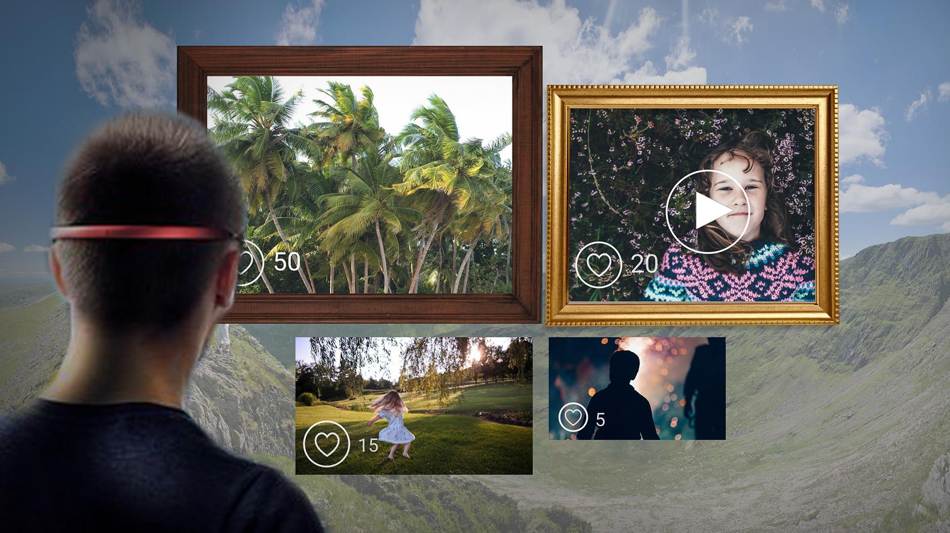
CONCEPT 2 - VR Gallery
Problem
What is the concept?
Privacy problem to control a privacy issue to share their pictures with others.
Users can exhibit their pictures or video’s on VR space with some people who got a permission from the host.

Slide 22
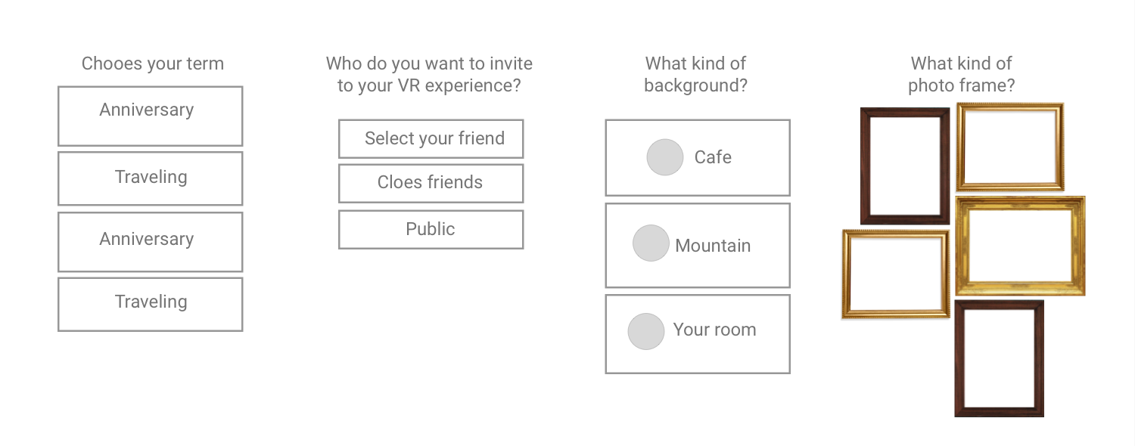
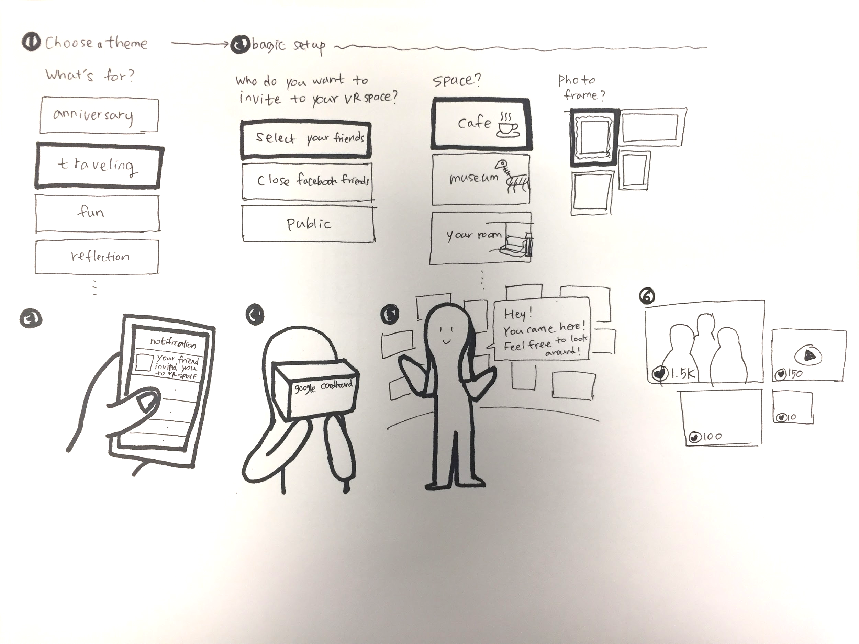
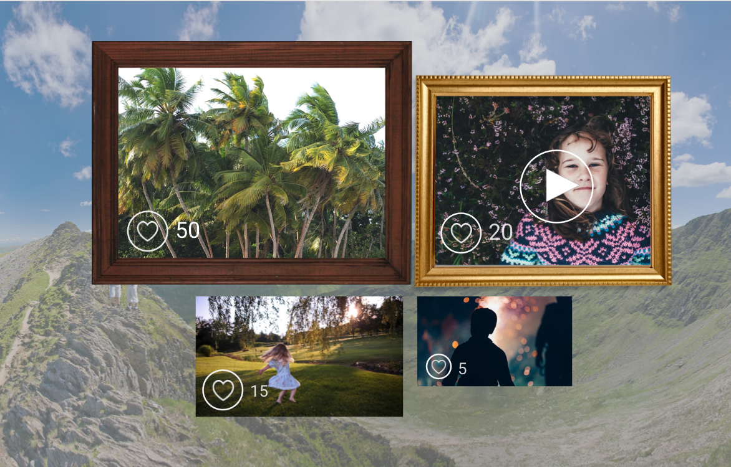
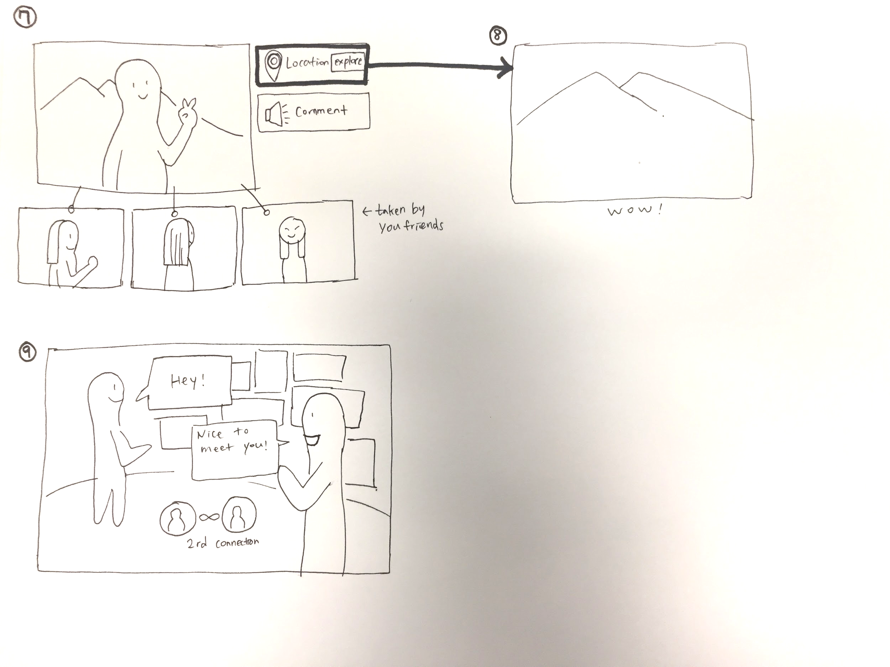
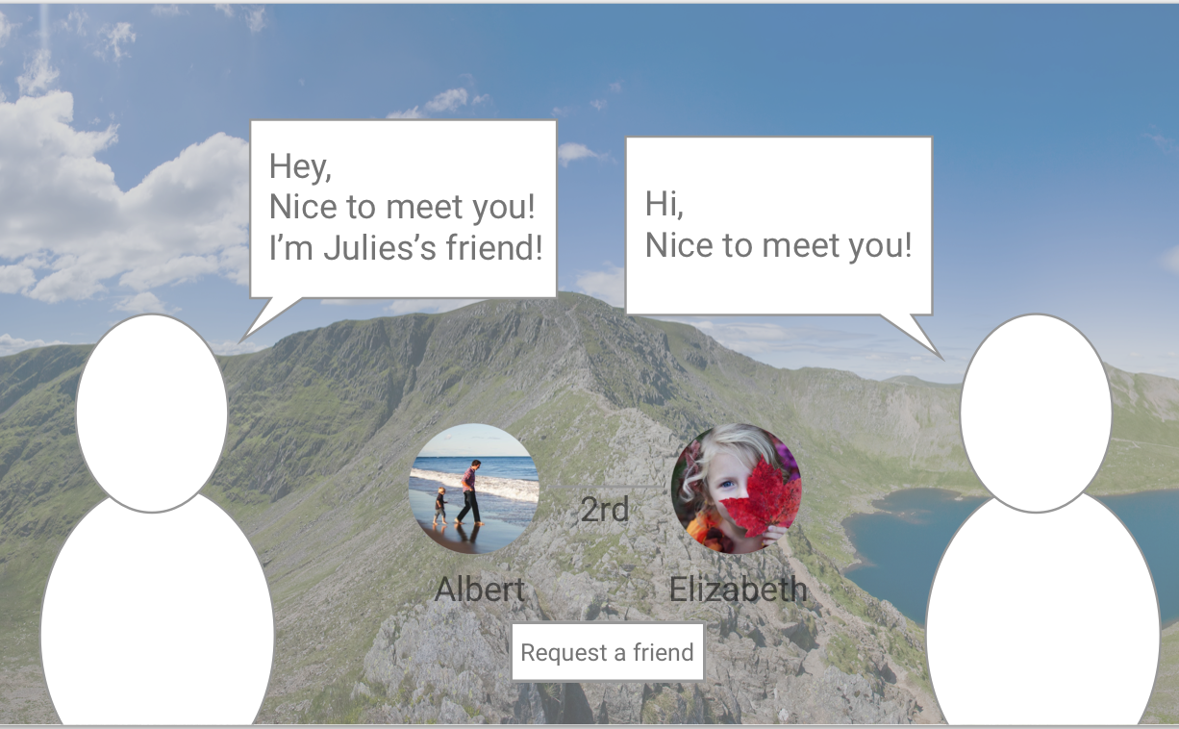
VR Gallery Scenario
1. Users get an invitation of Facebook VR from their friends..
2. They choose what theme for these pictures is, set up like who do you want to invite, and how they want to sort these pictures. They can also choose the background of VR space and photo frame of it.
3. The size of pictures would be bigger depending on how many thumbs-up or reactions the picture got from others and it could be smaller because it would get a low number of reactions(buttons) from others.
4. You can see other pictures related to the picture in different perspective views. You can also explore of the location of the picture and make a comment by recording your voice.
5. if there is another user who got invited from the host on VR space and also look around on the space, both can see each other and talk there.

Slide 23
CONCEPT 2 - VR Gallery
User’s values
Users can keep the data in a more flexible way.
Users can keep their memories/pictures in different perspective views.
Users can expand their network while enjoying contents in VR space.

Slide 24
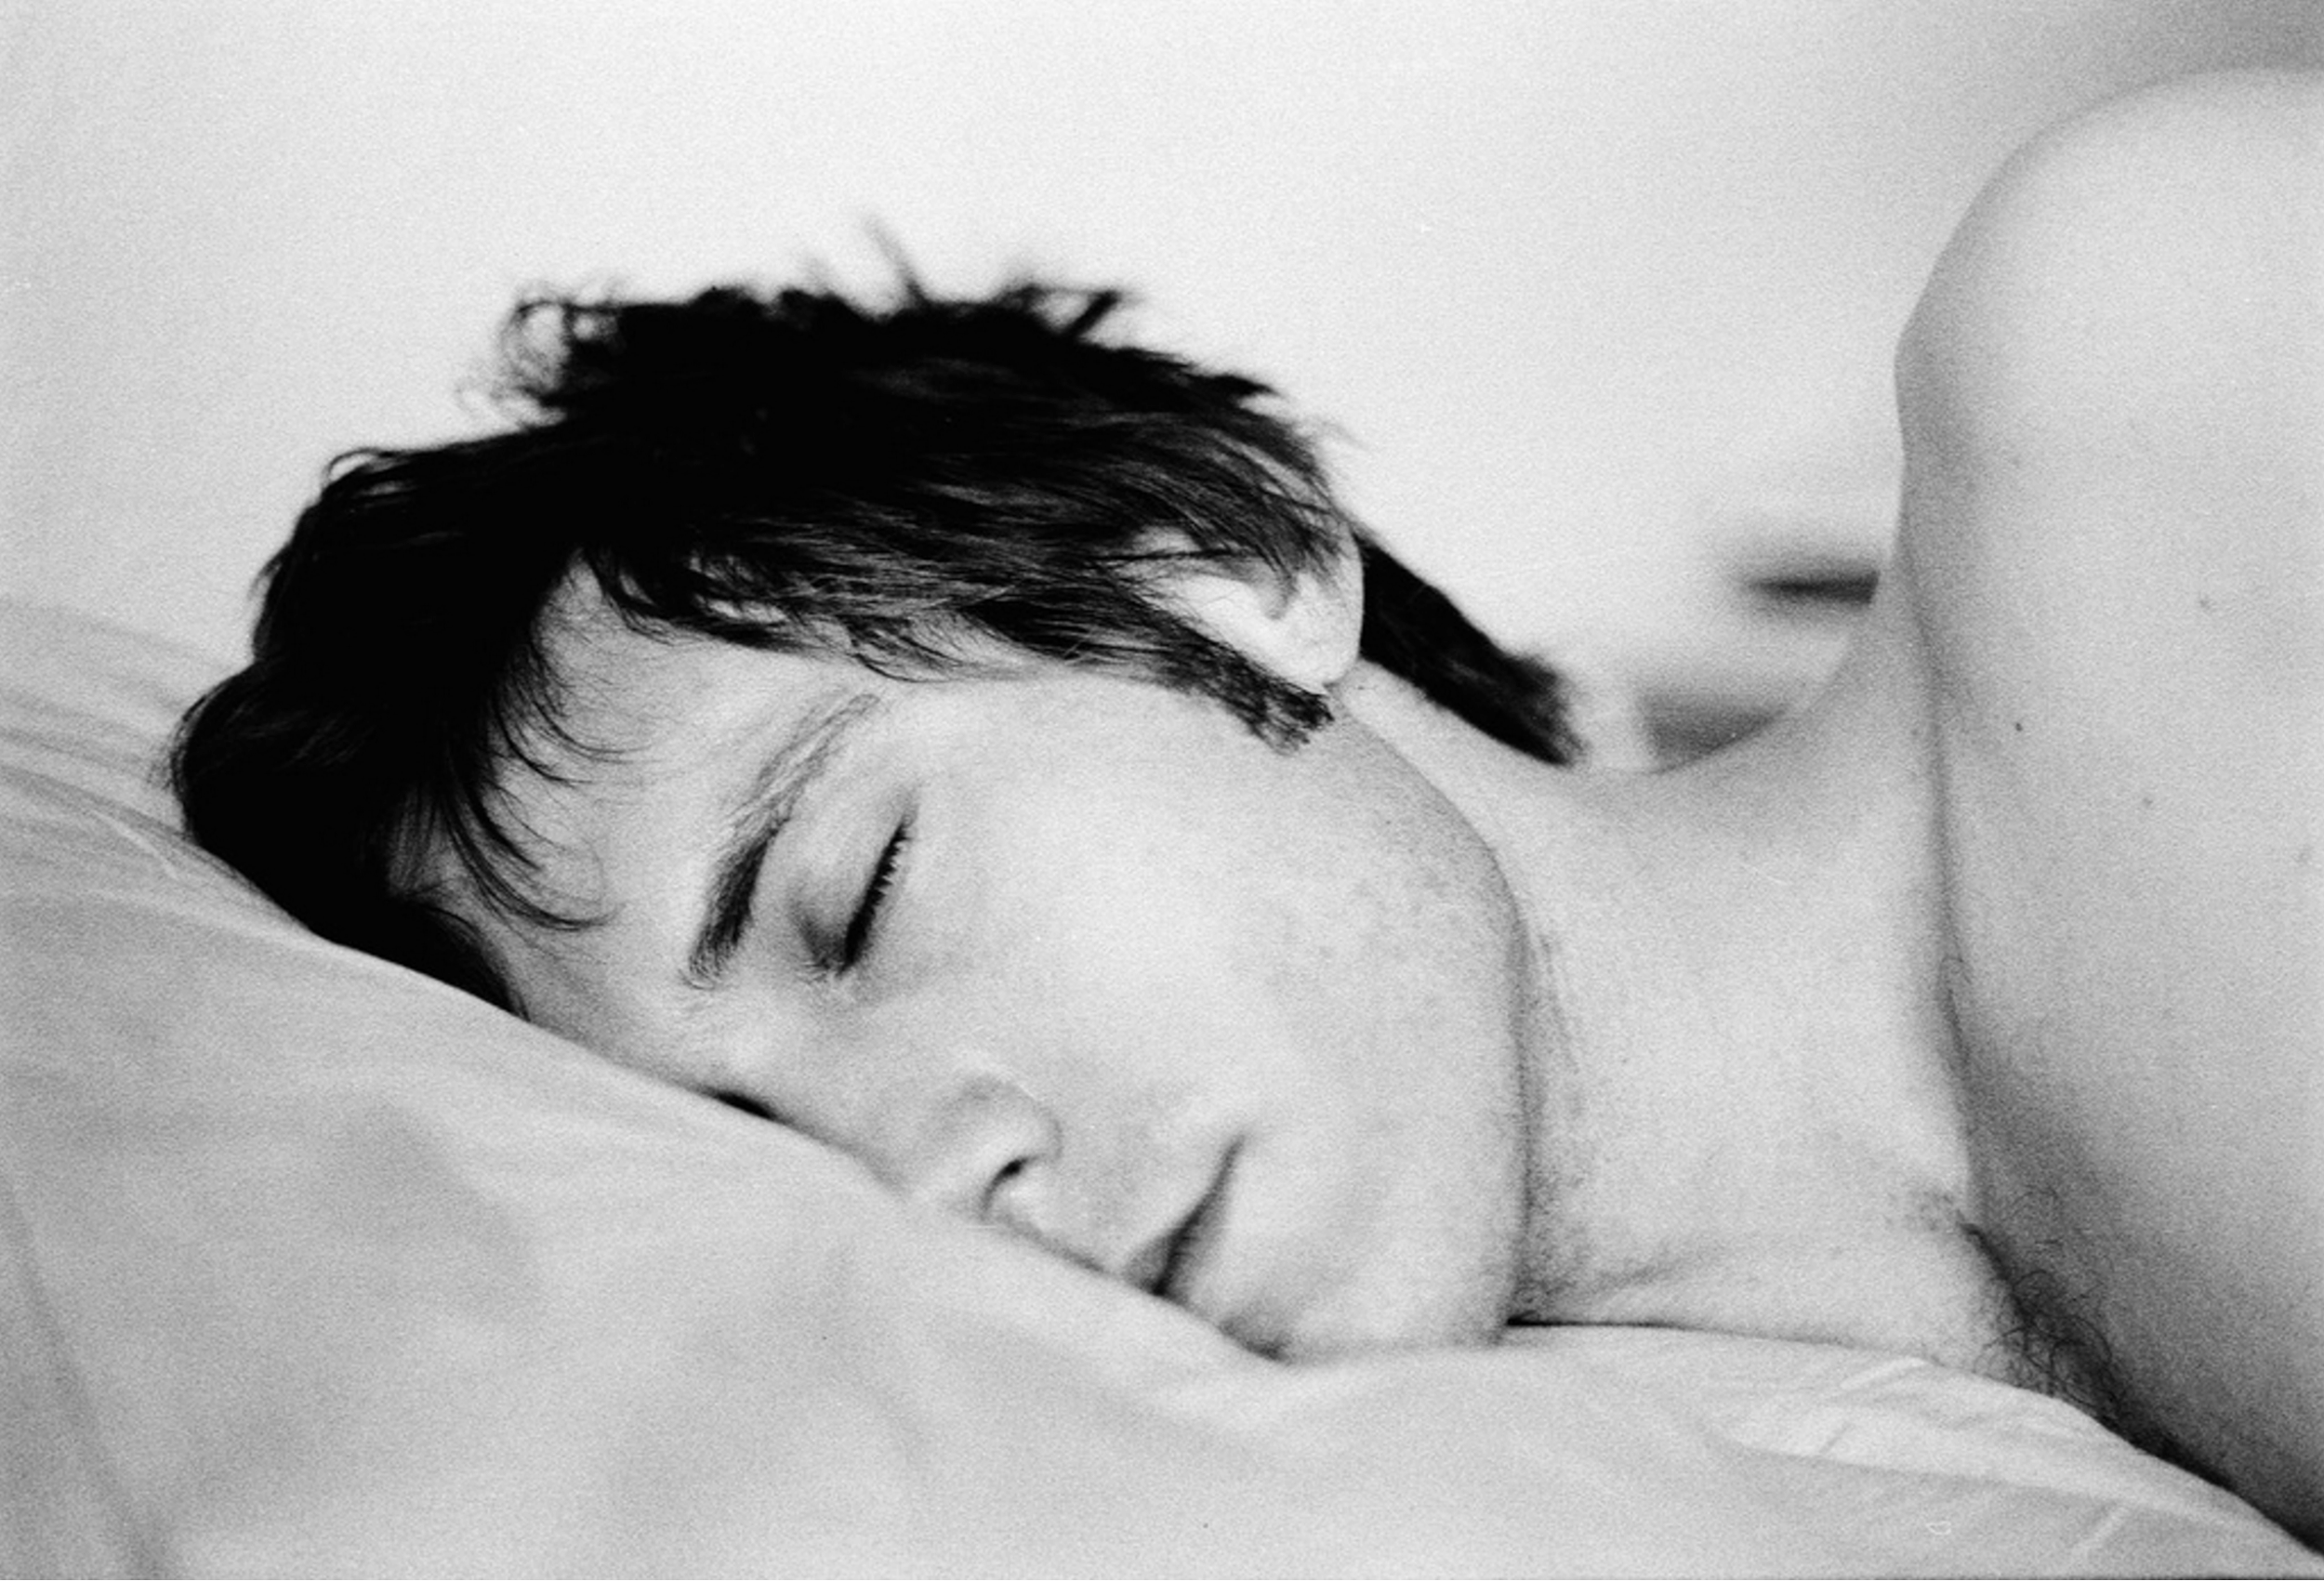
CONCEPT 3 - Dream Inducer
Problem
What is the concept?
Conversations and bouds between people and social platforms is week and should be facilitated with other approaches.
Before bedtime, users can enjoy VR video recommended according to the analysis of user’s emotion, which would induce users to have related dream that night and enhance the connection between users and surroundings.

Slide 25





CONCEPT 3 - Dream Inducer
Facebook
Account
Sweet Dream
Content Provider
Facebook
Third party studio
Self-record
INDUCE
ACCESS
Enjoy the Video
Facebook
Emotional Analyzer
SUPPORT
Content
Personal profile
Recent posts
Interactions
Friends activities
Album
Contacts
Activities (you really enjoyed last week)
Places (you always dreamed to go)
Mood booster
Greetings (recorded by your loved ones)
DISPLAY
VR Devices
DETERMINE
SUPPLEMENT

Slide 26
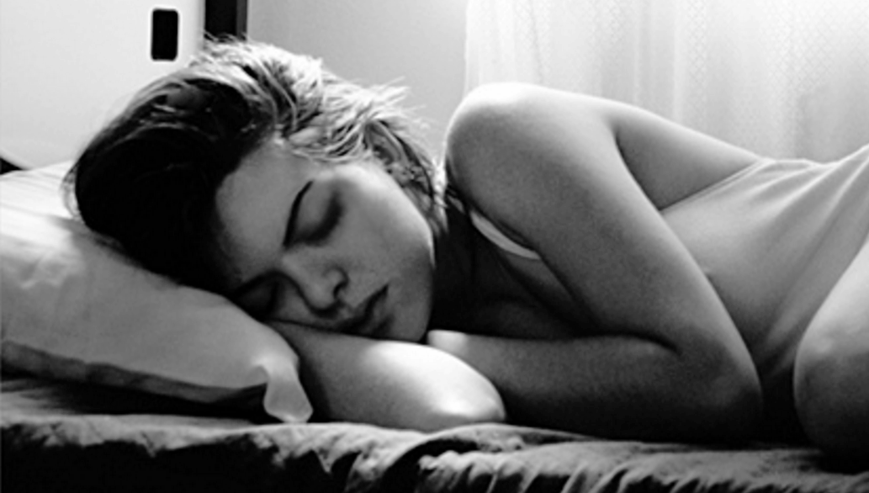
CONCEPT 3 - Dream Inducer
User’s values
Users could date back their memories through VR video before bedtime
Stronger connections with memorable friends and events.
Better sleeping experience with sweet dream induced by the device

Slide 27
Host events
VR Gallery
Dream Inducer
Business values for Facebook
Technological feasibility | 3D environment half real/half avatar | Google cardboard controller | Emotion analyzer
Revenue possibility | Increase average time spent on Facebook and bring more ads | Increase average time spent on Facebook and bring more ads | Charge users for better service
Strategic fits with Facebook goals | Bring engaging environment | Offer the way of creating richer contents to users | Explore the opportunity to offer more intuitive, personalized contents, stronger bonds with users

Slide 28
Thank you

